Slide 1
Unit 2. Structure and function of the nervous system: Molecular, cellullar, synaptic, and circuit levels.
2.1. The cells of the nervous system
2.2. Resting and action potential
2.3. Synaptic transmission
2.4. Synaptic plasticity

Slide 2
Compulsory reading
Carlson, N.R.; Birkett, M.A. (2017). Physiology of Behavior, Global edition. Pearson Education. Chapter 2
Other resources are available via moodle

Slide 3
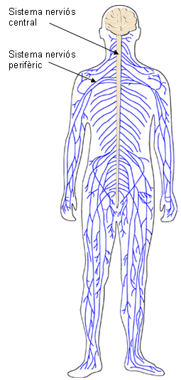
The cells of the nervous system
Central nervous system
Peripheral nervous system
Central nervous system (encephalon and spinal cord): Encased in bone (skull and vertebrae
Peripheral nervous system: distributed throughout the body

Slide 4
The cells of the nervous system: Neurons and glial cells
The cells of the nervous system: Neurons and Glial cells
Glial cells (glia)
Glial cells (glia)
Caruso Bavisotto et al. (2019). doi: 10.3390/ijms20020434.

Slide 5
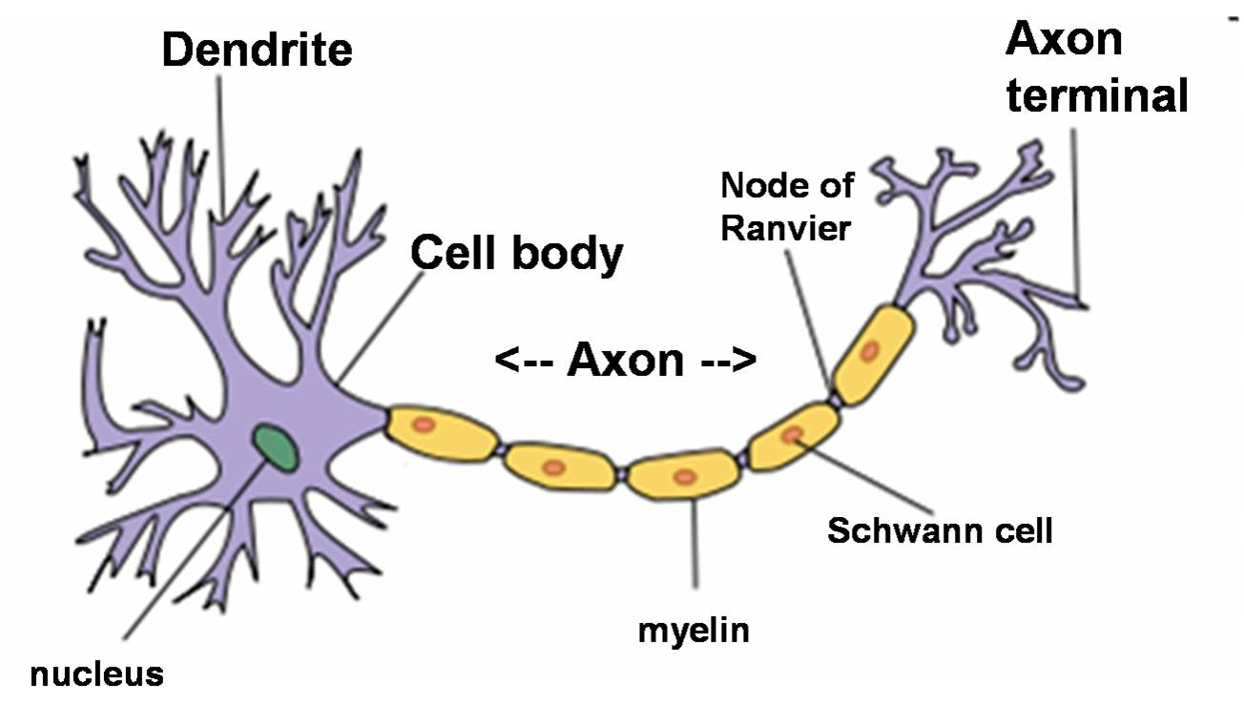
Neurons: Soma (cell body), axon and dendrites

Slide 6
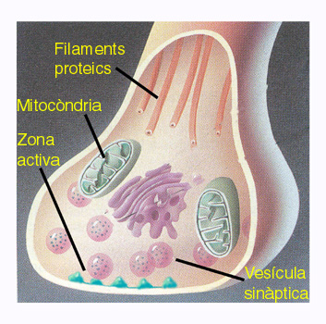
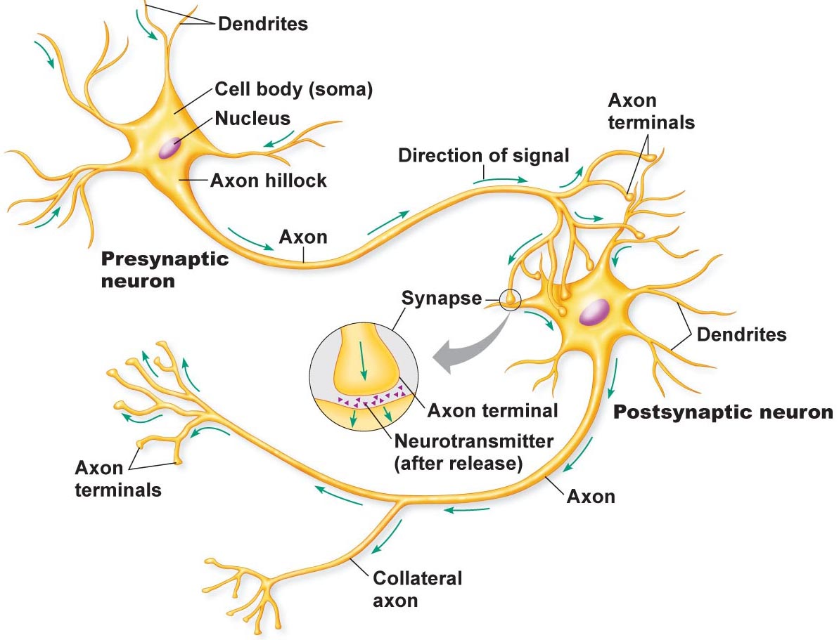
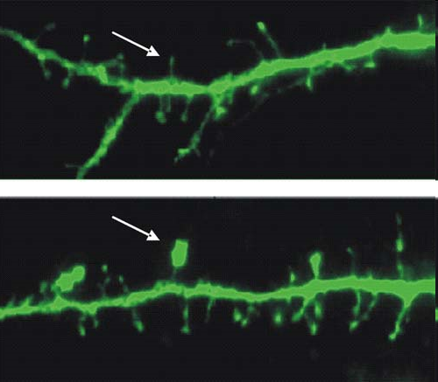
Neurons: Soma (cell body), axon and dendrites
Axon terminal (terminal bouton)
Dendrites with dendritic spines

Slide 7
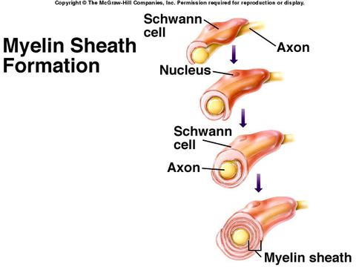
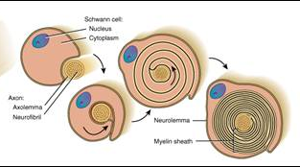
Neurons: Myelinated and unmyelinated axons
Myelinated fibers (axons): Axons individually wrapped with myelin, an electrical isolating substance made up of lipids and proteins
Myelin is formed by specialized cells:
In the peripheral nervous system (PNS): Schwann cells

Slide 8
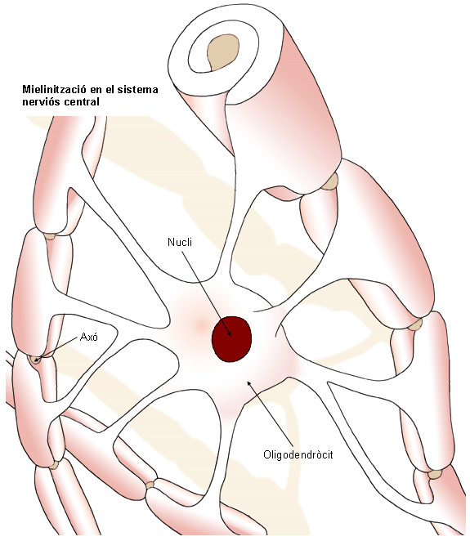
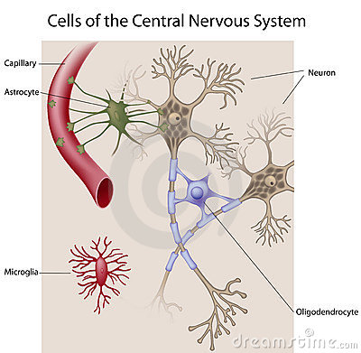
Neurons: Myelinated and unmyelinated axons
Axons individually wrapped with myelin, an electrical isolating substance made up of lipids and proteins
Myelin is formed by specialized cells:
In the central nervous system (CNS): Olygodendrocites

Slide 9
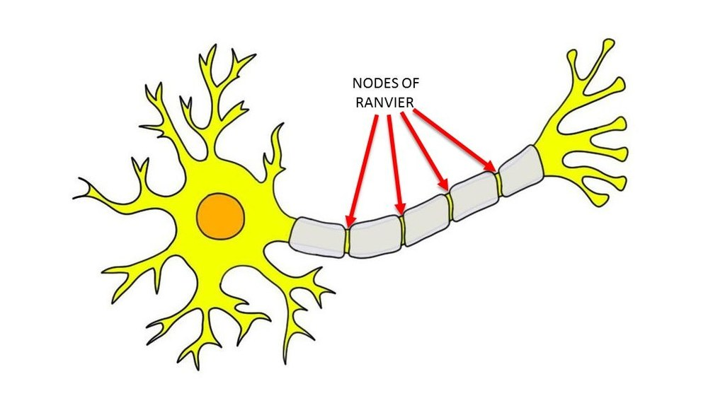
Neurons: Myelinated and unmyelinated axons
Myelinated axons have:
Internodes (parts of the axon covered with myelin)
Nodes of Ranvier: small spaces between two consecutive internodes that are not covered with myelin

Slide 10
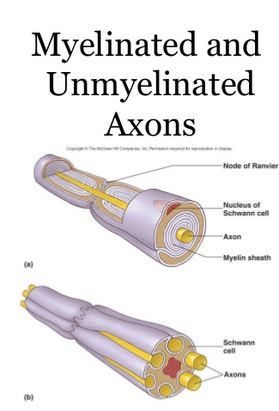
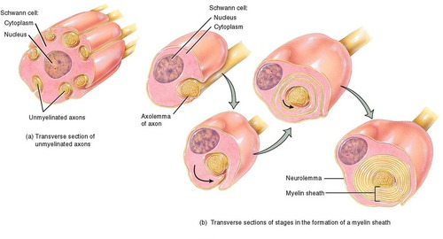
Neurons: Myelinated and unmyelinated axons
Unmyelinated fibers (axons): They are not individually wrapped with myelin, but there is myelin covering groups of axons
Unmyelinated
Myelinated

Slide 11
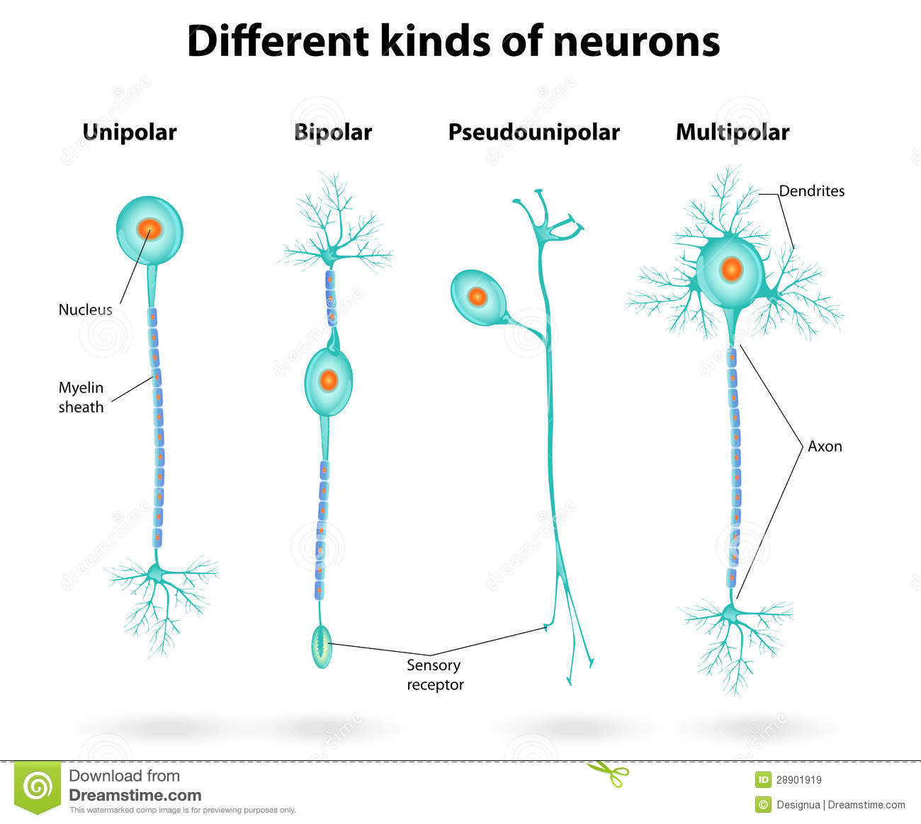
Neurons: CLASSIFICATION according to their morphology (number of ramifications or processes arising from the cell body)
Morphology = Shape, basic structural organization
This classification is based on the number of processes (main branches) going out from the cell bodye surten del soma)

Slide 12
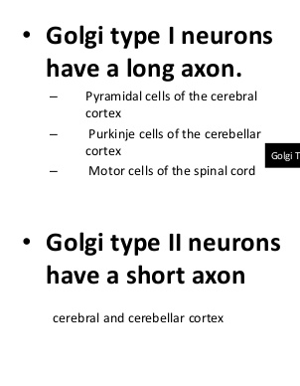
Neurons: CLASSIFICATION according to their morphology (number of ramifications or processes arising from the cell body)
Multipolar Golgy Type 1 neurons communicate with neurons located in a different (distant) part of the nervous system
Multipolar Golgy Type II neurons communicate with nearby

Slide 13
Neurons: CLASSIFICATION according to their function
CNS
AFFERENT to the CNS
Interneurons multipolar Golgi type I and Golgi type II
Sensory neurons. Most of them have a T-shaped pseudomonopolar morphology
EFFERENT to the CNS
Motor neurons They are multipolar Golgi type I
Afferent: Going to
Efferent: Leaving from

Slide 14
Some basic terms
Central nervous system
English | Català | Castellano | Meaning
Central nervous system (CNS) | Sistema nerviós central | Sistema nervioso central | Parts of the nervous system enclosed and protected within bony structures. Encephalon (encased in the skull) Spinal cord (protected by the spine)
Peripheral nervous system (PNS) | Sistema nerviós perifèric | Sistema nervioso periférico | Parts of the nervous system located outside the spinal cord and encephalon. It is composed of nerves (groups of axons in the PNS) and neuronal ganglia (groups of neuron cell bodies and dendrites in the PNS
Gray matter | Substància grisa | Sustancia o materia gris | Parts of the nervous tissue composed of neuronal cell bodies and dendrites. In the CNS cells bodies and dendrites (i.e., gray matter) is organized and distributed into nuclei and (in the cortex) cortical layers
White matter | Substància blanca | Sustancia blanca | Parts of the nervous tissue composed of axons. Bundles of axons are called “nerves” in the PNS, and “pathways” or “facicles” in the CNS
Peripheral nervous system

Slide 15
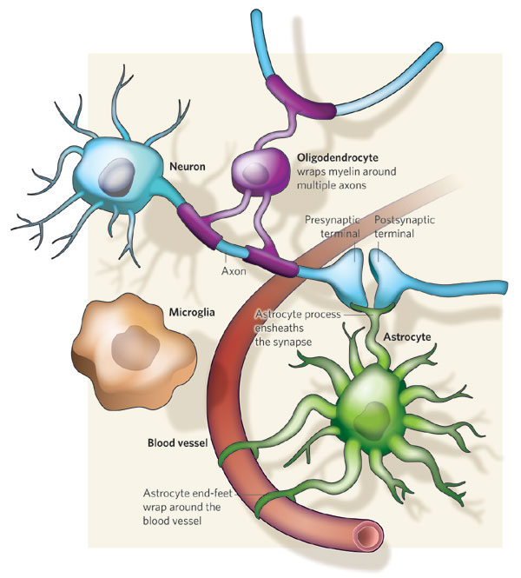
Glial cells
In the CNS
Astrocytes
Oligodendrocytes
Microglia cells
Eppendimal cells
In the PNS
Schwann cells
Satellite cells

Slide 16
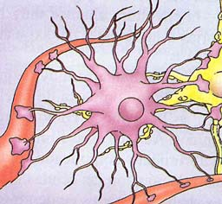
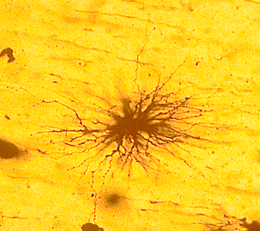
Glial cells
Astrocytes
Physical support to neurons
Regulation of blood-brain substance interchange
Astrocyte end feet
Regulation of the ionic and pH external fluids
Participate in blood brain barrier
Importance for some processes related to brain development (radial glia)
Immune reactions (phagocytosis, antigen presentation, etc)
Participates in synaptic communication (the “gliapse”).

Slide 17
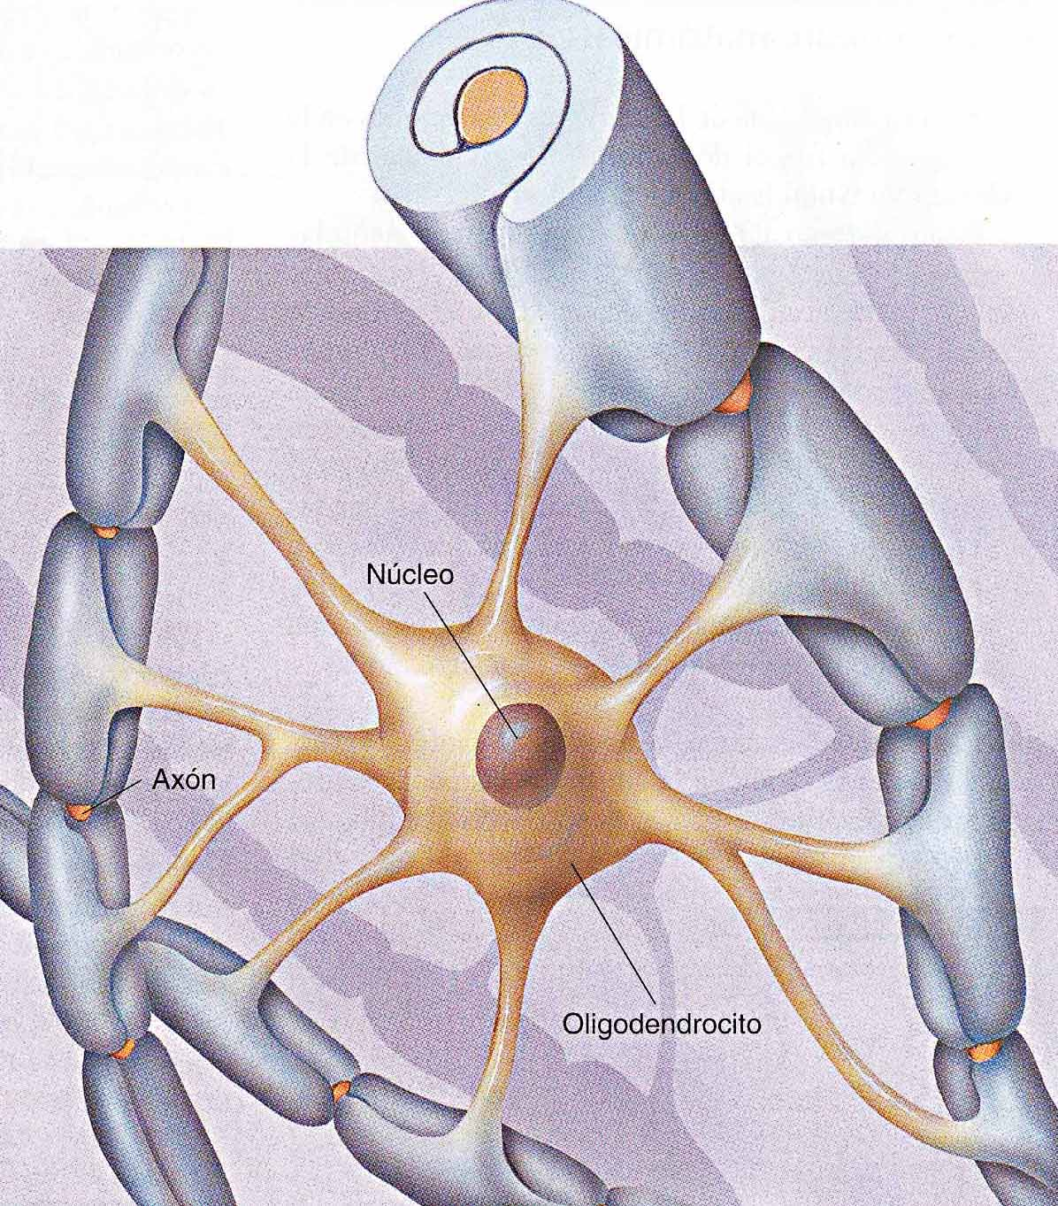
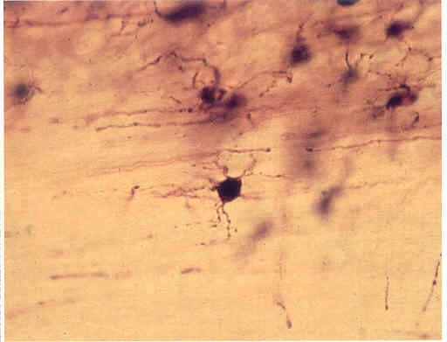
Glial cells
Oligodendrocytes
SNC myelin formation
Contributes to neuronal homeostasis
There are disorders related to myelin and olygodendrocytes alterations: Multiple sclerosis…

Slide 18
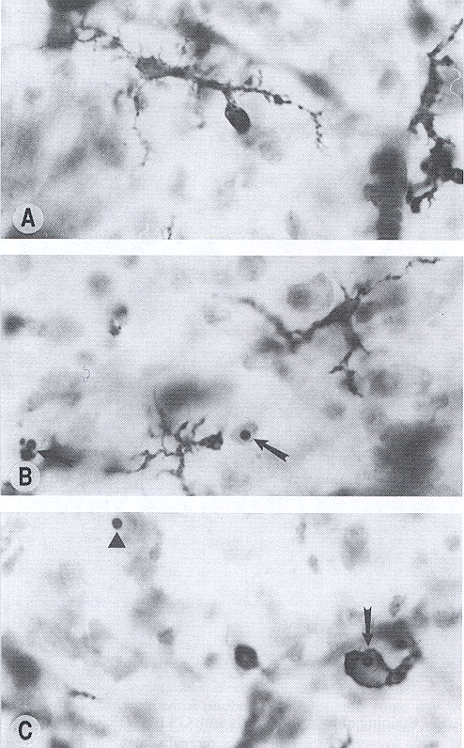
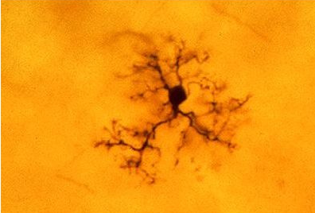
Glial cells
Microglial cells
Part of them are born inside the CNS (“resident” microglia), while others are derived from a kind of leucocytes (white blood cells) called macrophages
Immune functions
They have the ability to phagotize (engulf) debris (formed as a consequence of cell death, etc.

Slide 19
https://www.youtube.com/watch?v=7k5ca2UeLqI
https://www.youtube.com/watch?v=12wfAvoDNTA
https://www.youtube.com/watch?v=AwES6R1_9PM
https://www.youtube.com/watch?v=Utaeaz-tD5s
https://www.youtube.com/watch?v=L2t7eTYWnl0
https://www.youtube.com/watch?v=HOA-QW9xTa8

